Slide 1
Fantasy Football Team Optimization
Project Proposal
24-785 Engineering Optimization
Jaydutt Kulkarni
Aditya Rathi
Aditya Joglekar
Jeffrey Wang

Slide 2
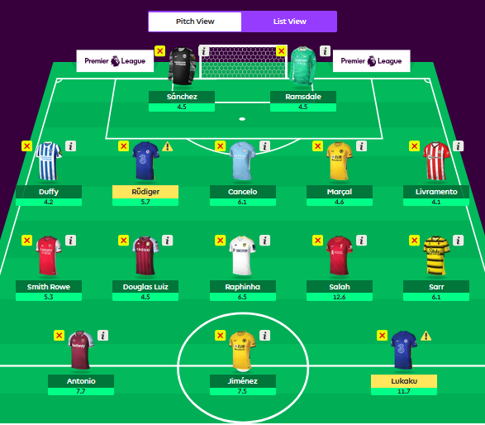
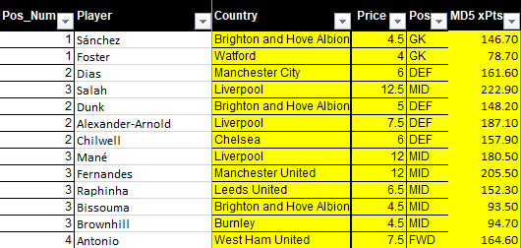
Introduction
The objective is to select 15 players, which includes 11 starters, 4 bench players, and 1 captain such that the fantasy team ends up scoring the most points throughout the season.
The game starts off with a fantasy team budget of 100m.
The goal of this optimization project is to maximize the Expected Value of the fantasy football team for a week.
The EV model predicts the points scored by each team per week
Notes:
With over 8 million players, Fantasy Premier League is the biggest Fantasy Football game in the world. It essentially assigns points for actions that are undertaken by football players in real life
The squad of 15 includes 2 GKs, 5 defenders, 5 midfielders, and 3 forwards. A starting lineup can be compromised of any feasible combination of players from these positions.
Expected Value model using Machine Learning algorithm is the starting point.
Finding the optimal EV team for each week is the end goal, with the first step being trying to optimise a reduced NLP version of this problem

Slide 3

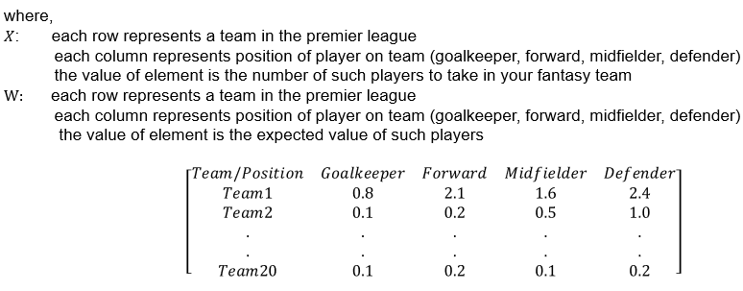
Objective Function

Slide 4
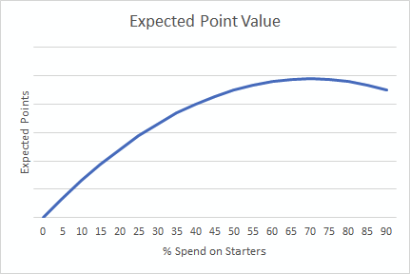
Selection and Cost Matrix
X is a function of the expected value/million of each club as well as the amount to spend on each team, as well as the % spend on the starting team vs bench
x: Selection matrix, # of players/team/position, expressed as a decimal value
S: % spend on starters
 | GK | FWD | MID | DEF
Team 1 | 0.5 | 1.2 | 0.1 | 0.1
Team 2 | 0.9 | 0.2 | 1.6 | 0.1
...
Team 20 | 0.2 | 1.4 | 0.2 | 0.3
Notes:
You can save some budget for higher quality bench players in case your starters do not play

Slide 5

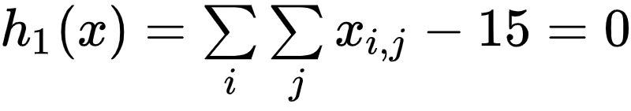










Constraints

Slide 6
Questions?

